Slide 1
CENG 207 SOLID STATE DEVICES INSTRUCTOR: NANA(DR.) KWASI DIAWUO
LECTURE 4: PN JUNCTION

Slide 2
OUTLINE
pn junction I-V characteristics
NOTE:
Typically, pn junctions in IC devices are formed by counter-doping. The equations derived in class (and in the textbook) can be readily applied to such diodes if
N_{A} ≡ net acceptor doping on p-side (N_{A}-N_{D})_{p-side}
N_{D} ≡ net donor doping on n-side (N_{D}-N_{A})_{n-side}

Slide 3

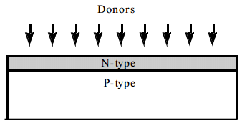
introduction
P-N junctions are of great importance in understanding semiconductor devices
A p-n junction is a two terminal device
A p–n junction is formed at the boundary between a p-type and n-type semiconductor created in a single crystal of semiconductor by doping, for example by ion implantation, diffusion of dopants, or by epitaxy

Slide 4
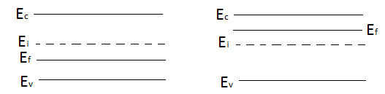

Equilibrium process
Before the junction is formed, we have separate regions of p-type and n-type material
p-type n-type
Upon joining the two regions, we expect diffusion of carriers until equilibrium. At equilibrium, the Fermi energy level must be the same throughout the system
P-N junction

Slide 5
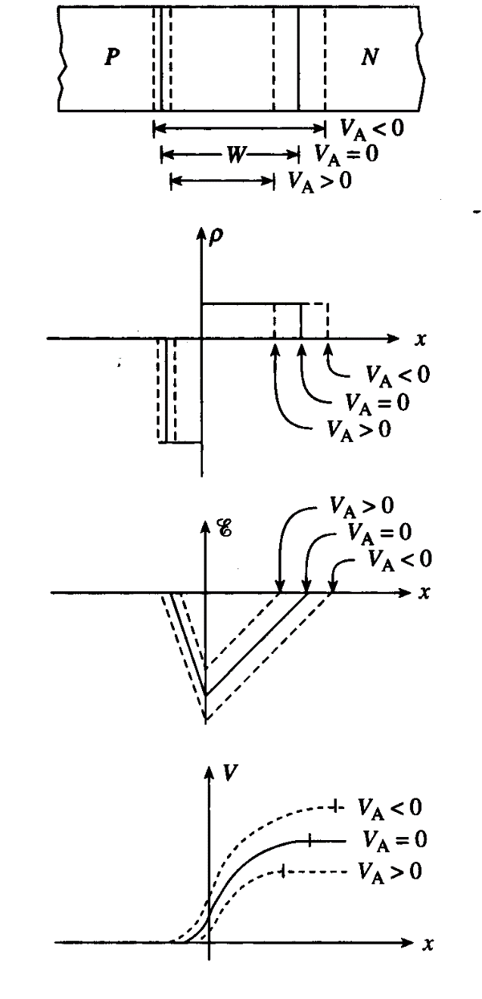
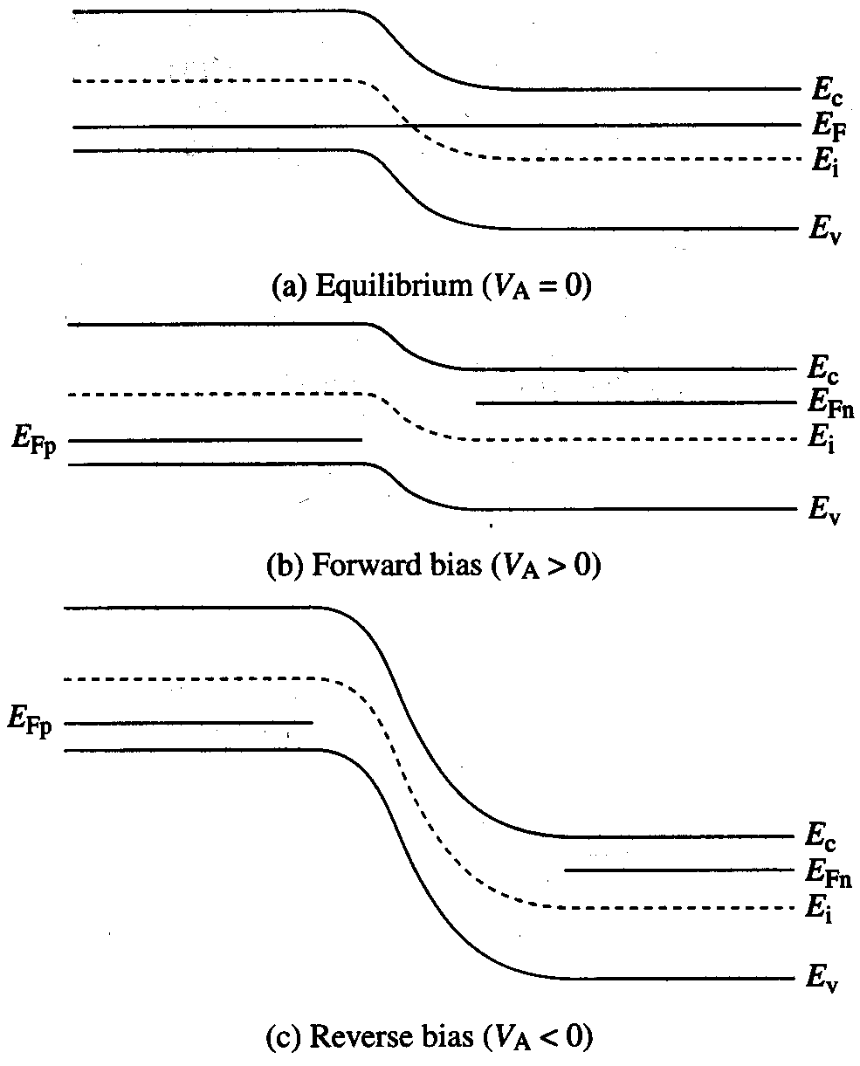
Effect of Bias on Electrostatics

Slide 6
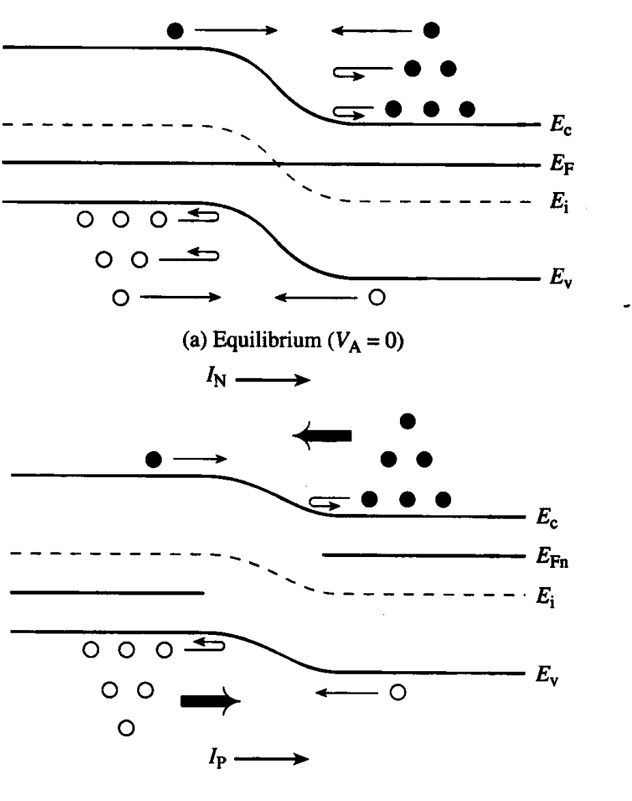
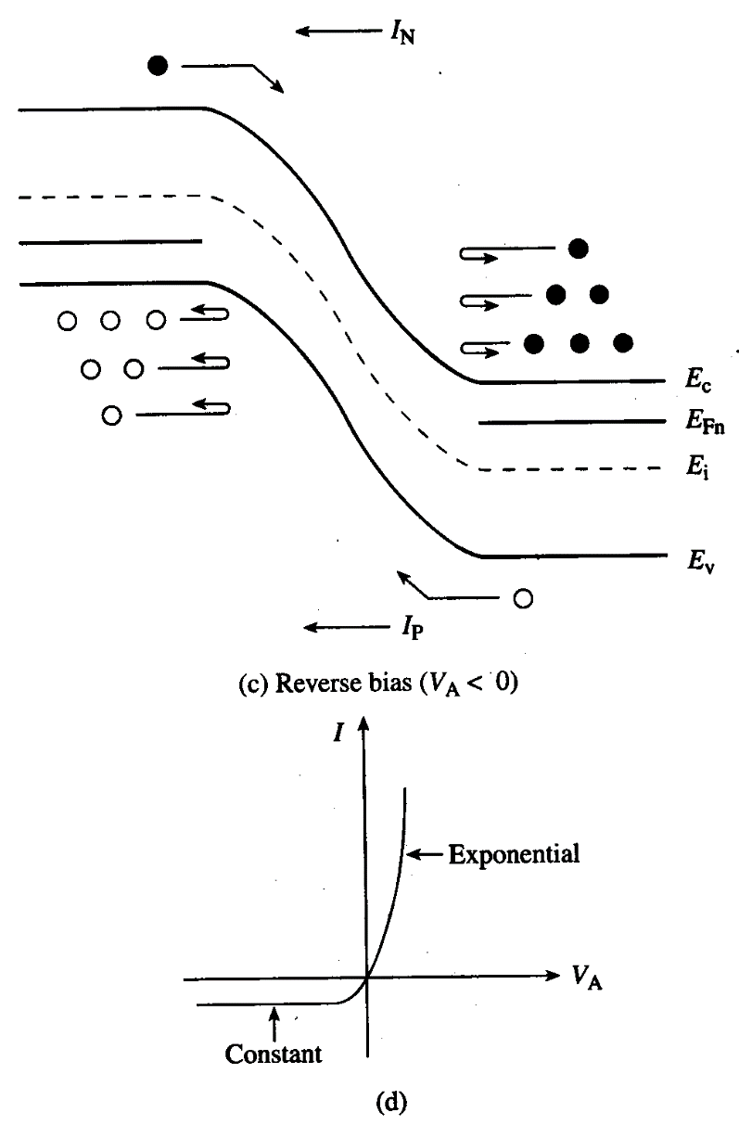
Current Flow - Qualitative

Slide 7
Current Flow in a pn Junction Diode
When a forward bias (V_{A}>0) is applied, the potential barrier to diffusion across the junction is reduced
Minority carriers are “injected” into the quasi-neutral regions => Δn_{p} > 0, Δp_{n} > 0
Minority carriers diffuse in the quasi-neutral regions, recombining with majority carriers

Slide 8
Current density J = J_{n}(x) + J_{p}(x)
J is constant throughout the diode, but J_{n}(x) and J_{p}(x) vary with position

Slide 9
Ideal Diode Analysis: Assumptions
Non-degenerately doped step junction
Steady-state conditions
Low-level injection conditions prevail in the quasi-neutral regions
Recombination-generation is negligible in the depletion region
i.e. J_{n} & J_{p} are constant inside the depletion region

Slide 10
Ideal Diode Analysis: Approach
Solve the minority-carrier diffusion equations in quasi-neutral regions to obtain Δn_{p}(x,V_{A}),Δp_{n}(x,V_{A})
apply boundary conditions
p-side: Δn_{p}(-x_{p}), Δn_{p}(-∞)
n-side: Δp_{n}(x_{n}), Δp_{n}(∞)
Determine minority-carrier current densities in quasi-neutral regions
Evaluate J_{n} at x=-x_{p} and J_{p} at x=x_{n}
J(V_{A}) = J_{n}(V_{A})|_{x=-xp} + J_{p}(V_{A} )|_{x=xn}

Slide 11
Carrier Concentrations at –x_{p}, x_{n}
Consider the equilibrium (V_{A} = 0) carrier concentrations:
p-side
n-side
If low-level injection conditions prevail in the quasi-neutral
regions when V_{A} ≠ 0, then

Slide 12
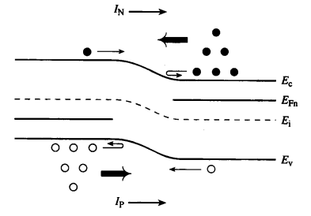
“Law of the Junction”
The voltage V_{A} applied to a pn junction falls mostly across
the depletion region (assuming that low-level injection conditions prevail in the quasi-neutral regions).
We can draw 2 quasi-Fermi levels in the depletion region:

Slide 13
Excess Carrier Concentrations at –x_{p}, x_{n}
p-side
n-side

Slide 14
Example: Carrier Injection
A pn junction has N_{A}=10¹⁸ cm⁻³ and N_{D}=10¹⁶ cm⁻³. The applied voltage is 0.6 V.
Question: What are the minority carrier concentrations at the depletion-region edges?
Answer:
Question: What are the excess minority carrier concentrations?
Answer:

Slide 15
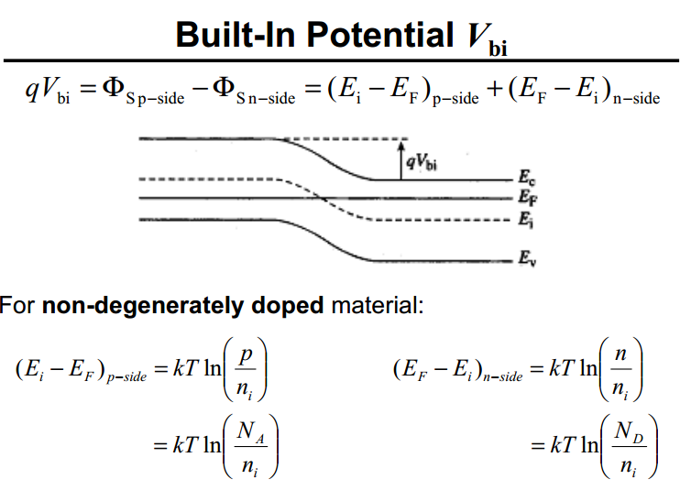

Slide 16




Built-in potential
On the n-side,
On the p-side,
Hence at the barrier,
And the Built-in potential is
The contact potential depends on doping(ND, NA) and temperature T

Slide 17
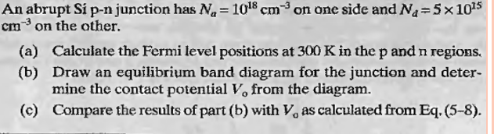

Slide 18
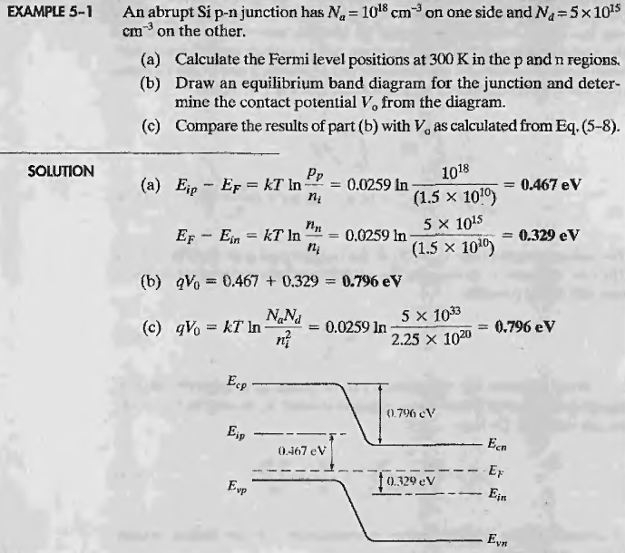

Slide 19
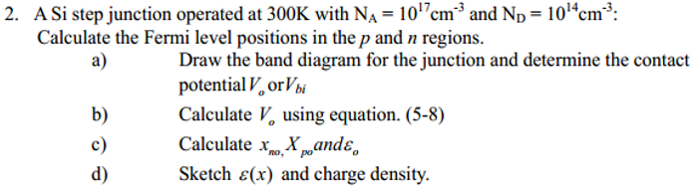

Slide 20
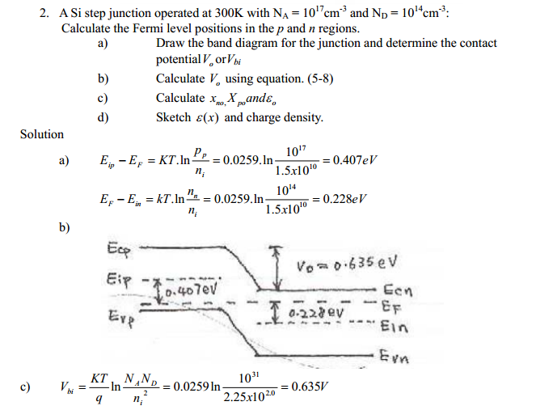

Slide 21
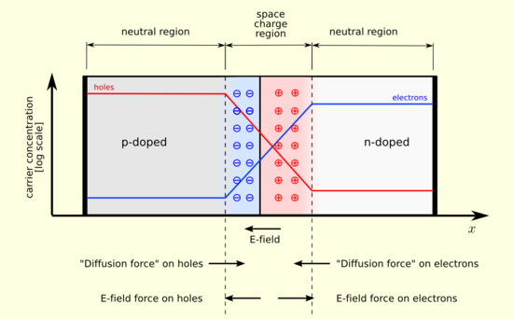
After joining p-type and n-type semiconductors, electrons near the p–n interface tend to diffuse into the p region. As electrons diffuse, they leave positively charged ions (donors) in the n region.
Likewise, holes near the p–n interface begin to diffuse into the n-type region, leaving fixed ions (acceptors) with negative charge.
The regions nearby the p–n interfaces lose their neutrality and become charged, forming the space charge region or depletion layer

Slide 22
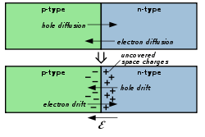
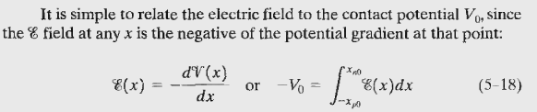
The uncompensated ions are positive on the N side and negative on the P side. This creates an electric field that provides a force opposing the continued exchange of charge carriers.
The electric field opposes the diffusion of majority carriers and sweeps minority carriers across the junction
Integrating the electric field across the depletion region determines what is called the built-in voltage (also called the junction voltage or barrier voltage or contact potential).

Slide 23
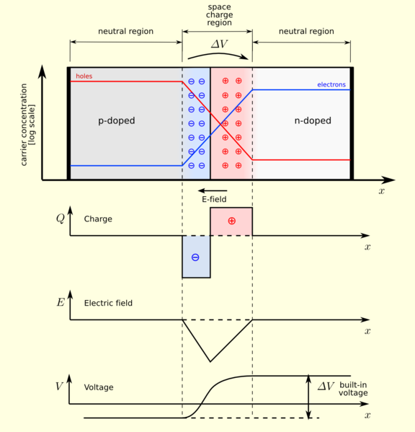
In a "p–n" junction, without an external applied voltage, an equilibrium condition is reached in which a potential difference is formed across the junction.
This potential difference is called built-in potential .
Charge density
Electric field
Electric potential

Slide 24
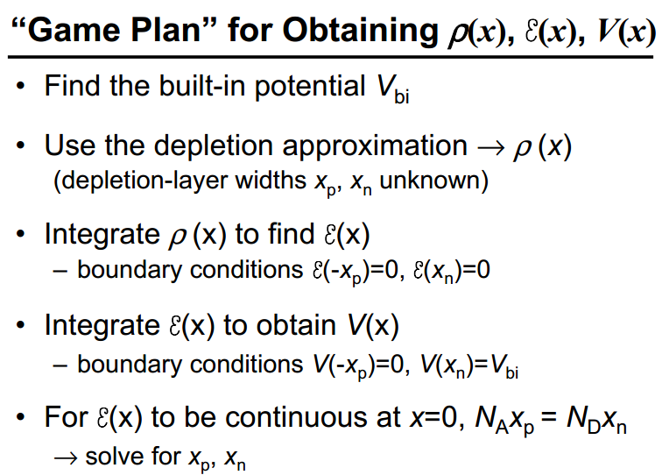

Slide 25
Space charge
The space charge in a semiconductor is determined by both the doping concentrations and the free-carrier concentrations,
ρ = (p- n+ ND - NA)q
In the neutral region of a semiconductor, n =ND and p = NA, so that the space-charge density is zero.
In the vicinity of a junction formed by different materials, dopant types, or doping concentrations, n and p could be smaller or larger than ND and NA, respectively. In the depletion approximation, n and p are assumed zero so that the space charge is equal to the majority-carrier doping level.

Slide 26
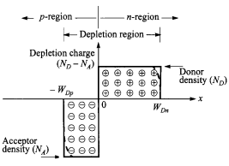
We proceed to calculate the field and potential distribution inside the depletion region.
The depletion approximation is used which assumes that the depleted charge has a box profile. Since in thermal equilibrium the electric field in the neutral regions (far from the junction at either side) of the semiconductor must be zero, the total negative charge per unit area in the p-side must be precisely equal to the total positive charge per unit area in the n-side:
NA WDp = ND WDn

Slide 27
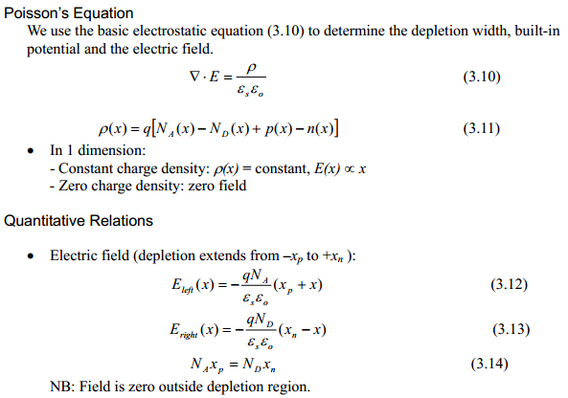

Slide 28
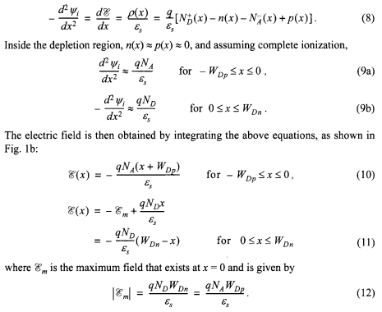
ELECTRIC FIELD

Slide 29
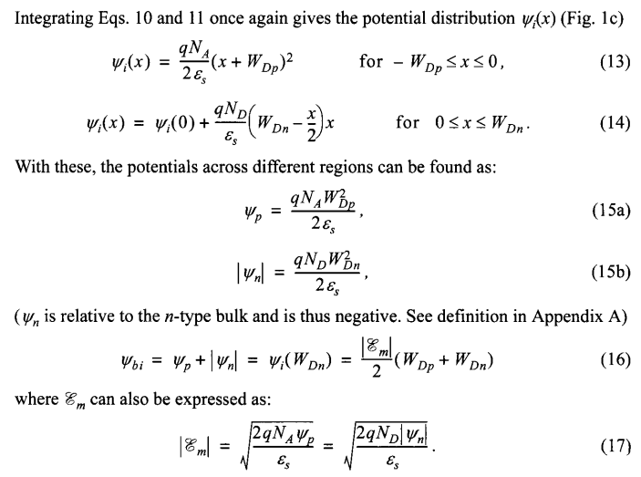
Potential

Slide 30
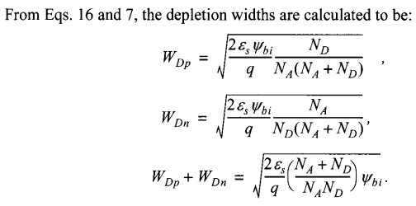

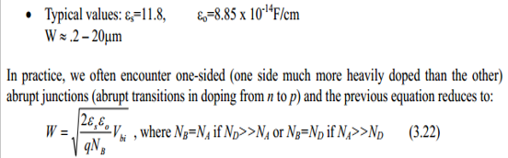
DEPLETION WIDTH
i
W_{Dp} + W_{Dn} =

Slide 31
pn Junction Electrostatics, V_{A} ≠ 0
Built-in potential V_{bi} (non-degenerate doping):
Depletion width W :

Slide 32
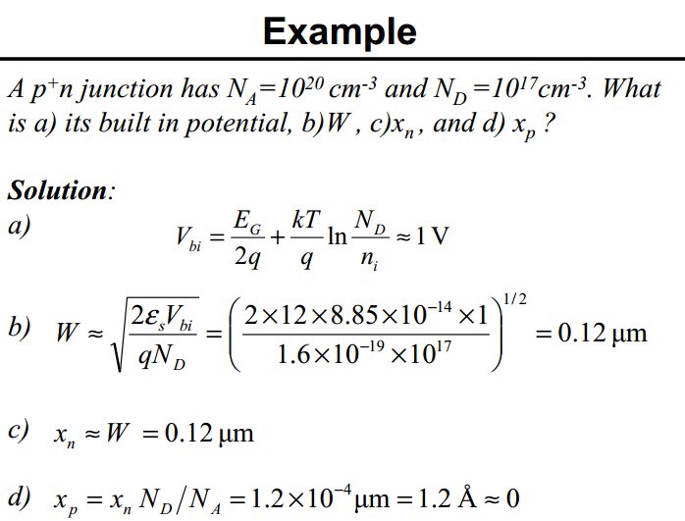

Slide 33
